Slide 1
Message Passing, Scheduler
Reference on Message Passing
  Tanenbaum ch. 2.3.8
Reference on Scheduler
  Tanenbaum ch. 2.5

Slide 2
Message Passing Basics
Motivation
  solve mutual exclusion problem with distributed CPUs, each with its own private memory
APIs
  send (destination, &message);
  receive(source, &message);
Producer-Consumer problem
  flow of data messages from producer to consumer
  issues:
    lost messages: fixed by using acknowledgements
    run-away producer: fixed by having consumer send empty messages and producer after receiving the empty one send back a full one

Slide 3
Producer-Consumer Problem with Messages
#define MSGSIZE sizeof(message)
#define N 10
mgd_t msgq_data, msgq_empties;
int main()
{
struct mq_attr attr;
attr.mq_maxmsg = N; /* not effective as limit on producer */
attr.mq_msgsize = MSGSIZE;
attr.mq_flags = 0;
msgq_data = mq_open(“/mqdata”, O_CREAT|O_RDWR, 0666, &attr);
msgq_empties = mq_open(“/mqempties, O_CREAT|O_RDWR , ...);
create_thread(consumer, ...);
create_thread(producer, ...);
getchar();
}

Slide 4
Producer-Consumer Problem with Messages (cont’d)
void producer(void)
{
int item; message m;
while (TRUE) {
item = produce_item();
/* wait for empty */
mq_receive(msgq_empties, &message, MSGSIZE, 0);
build_message(&m, item);
mq_send(msgq_data, &m, MSGSIZE, 1 /*priority*/);
}
}
void consumer(void)
{
int item, i; message m;
for (i=0;i<N;i++)
mq_send (msgq_empties, &m, MSGSIZE, 1); /* or put this in main *
while (TRUE) {
mq_receive(msgq_data, &message, MSGSIZE, 0);/* wait for data*/
item = extract(&m);
mq_send(msgq_empties, &m, MSGSIZE, 1); /* send empty */
consume_item(item);
}
}

Slide 5
Mailboxes
Mailboxes are created to buffer a fixed number of messages
Addresses in send and receive API are mailboxes not processes
When a process tries to send to a mailbox that is full, it is blocked until a message is removed from that mailbox

Slide 6
Classical Interprocess Communication Problems
The Dining Philosopher Problem
The Readers and Writers Problem

Slide 7

The Dining Philosopher Problem
Philosophers eat/think
Eating needs 2 forks
Pick one fork at a time
How to prevent deadlock

Slide 8
A Non-solution to The Dining Philosopher Problem
#define N 5
void philosopher(int i) {
while (TRUE) {
think();
take_fork(i); /* wait for i^{th} fork to be available and seize it */
take_fork((i+1) % N); /* wait for i+1th fork to be available and seize it */
eat();
put_fork(i); /* put down i^{th} fork */
put_fork((i+1) % N); /* put down i+1th fork */
}
}

Slide 9
Two Modifications to the Non-solution
2a. Add down on mutex here
#define N 5
void philosopher(int i) {
while (TRUE) {
think();
take_fork(i);
take_fork((i+1) % N);
eat();
put_fork(i);
put_fork((i+1) % N);
}
}
If (i+1)^{th} fork is not available, put down
the i^{th} fork. Re-try take_fork i^{th ,}, (i+1)^{th} at some other time .
** Starvation Problem **
2b. Add up on mutex here
** Only 1 philosopher eats at a time **

Slide 10
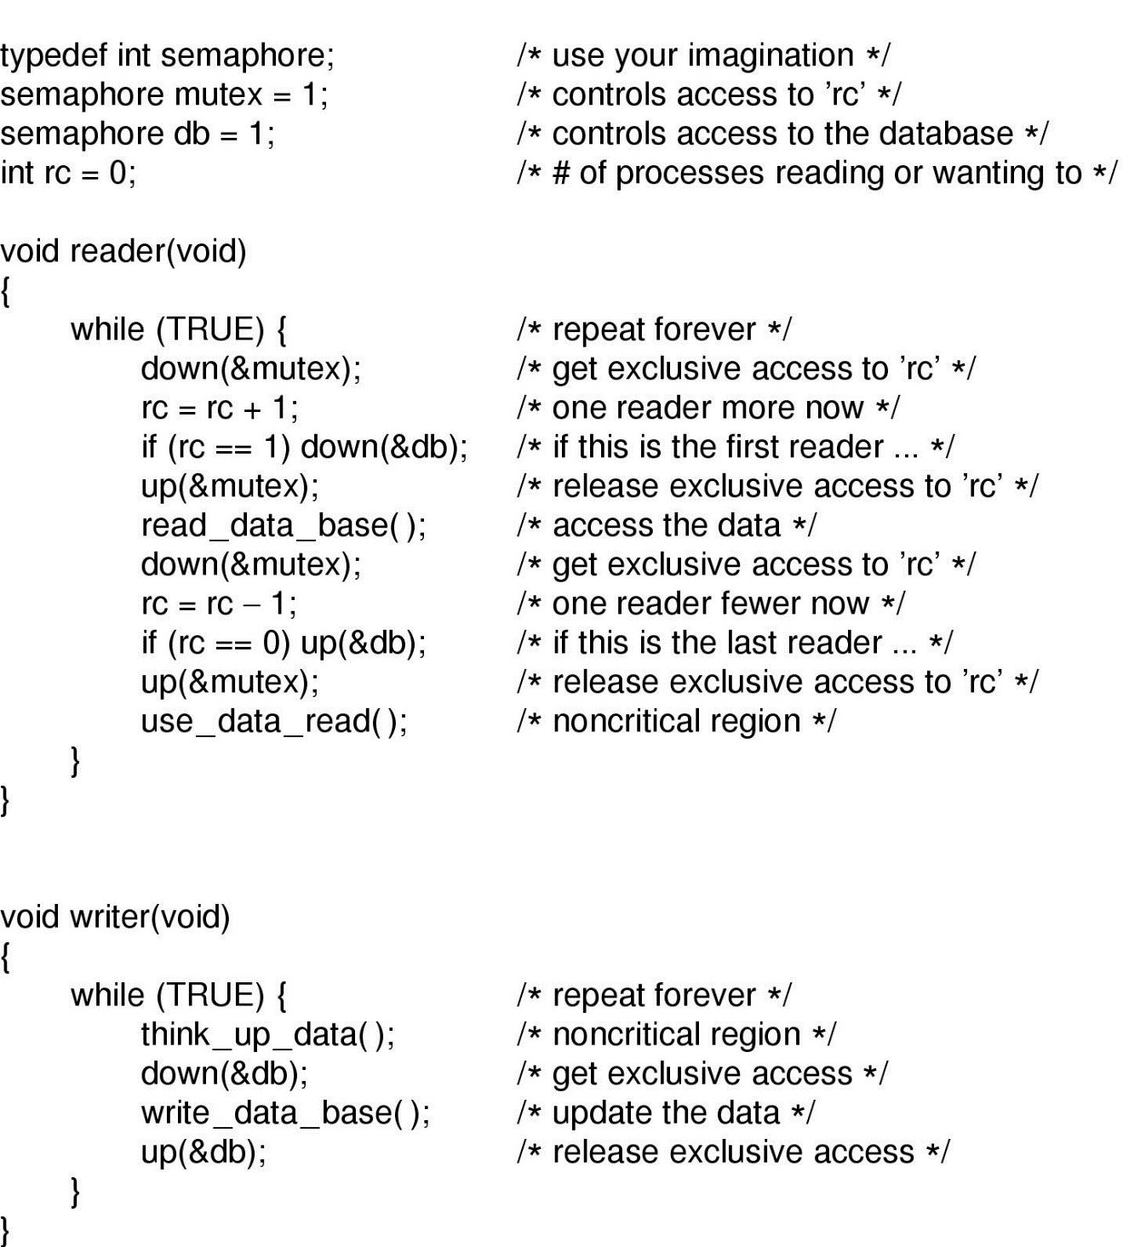
The Readers and Writers Problem

Slide 11

Scheduling
Introduction
  CPU makes the choice which process to run next
  Bursts of CPU usage alternate with periods of I/O wait
    a CPU-bound process
    an I/O bound process

Slide 12
Scheduling Algorithms
Non-preemptive
  picks a process to run and run until it exits or blocks (on I/O or waiting for another process)
  no scheduling decision made during clock interrupts
Preemptive
  picks a process to run and run for a maximum of some fixed time (quantum)
  a clock interrupt occurs at the end of time interval. Process is suspended and scheduler picks another process to run

Slide 13
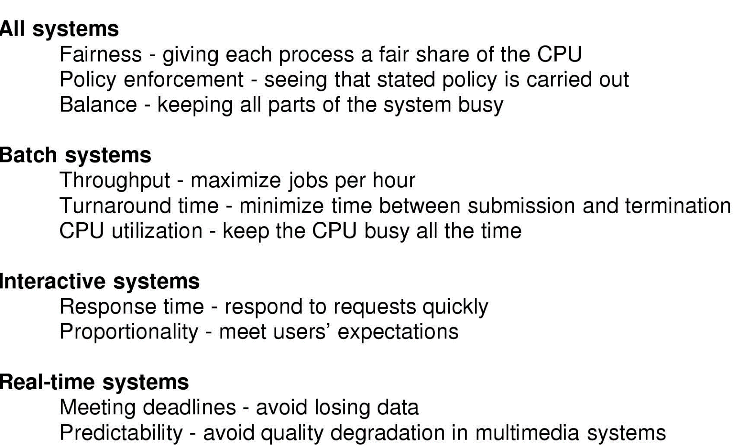
Scheduling Algorithm Goals

Slide 14
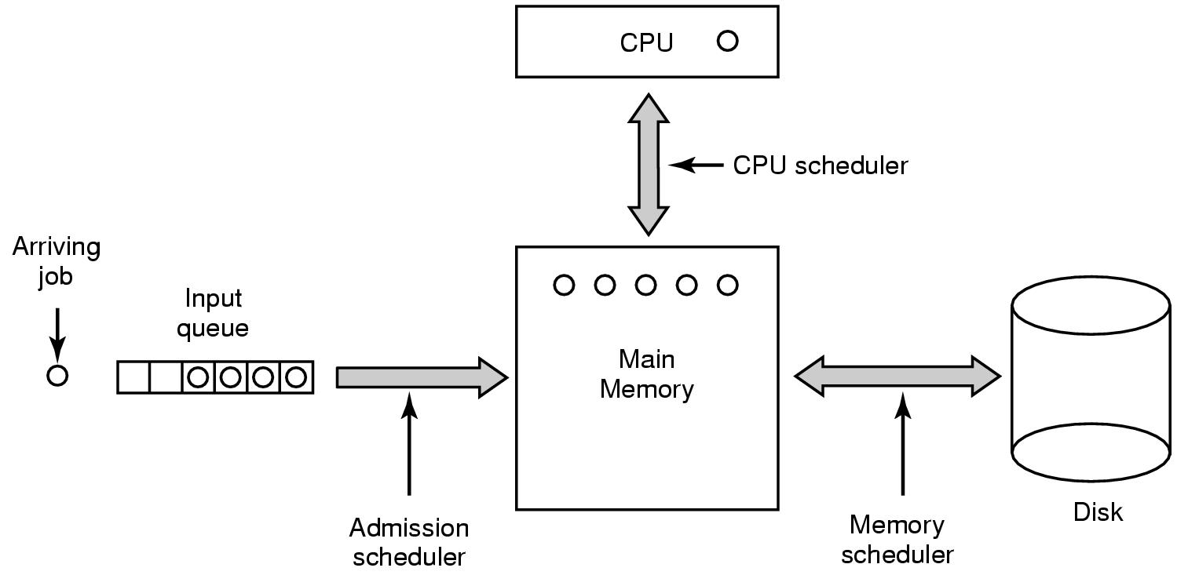
Scheduling in Batch Systems
Non-preemptive scheduler
Three levels of scheduling
  admission: which job to run?
  memory: how many and what kind of processes?
  CPU: which process in memory to run?

Slide 15
Scheduling in Interactive Systems
Preemptive Scheduler
Round-Robin
  time interval called quantum ~50ms
  overhead time due to process(context) switching
Arrival order
LAST
TASK 3
TASK 2
TASK 2
FIRST
TASK 1
TASK 1
TIME

Slide 16
Comparing Scheduling Algorithms
For example: CPU-intensive task takes 1 sec to complete and a bunch of I/O-intensive tasks take very little time to complete
Non-preemptive Scheduler:
  Run CPU-intensive task to completion;
  Run I/O-intensive task to completion;
  Run CPU-intensive task to completion and so on…
Pre-emptive Scheduler:
  Run CPU-intensive task for 10 msec;
  Run I/O-intensive task to completion;
  Run CPU-intensive task for 10 msec and so on…

Slide 17
Example of Scheduling Algorithms (cont’d)
Non-Preemptive Scheduler
  Can only run I/O-intensive task once per sec.
  1000 I/Os take 1000 seconds
Preemptive Scheduler
  Can run I/O-intensive task once every 10 msec
  1000 I/Os take 10 seconds
  CPU-intensive task takes slightly longer to complete (1 + # of I/O interrupts * ISR handling time)

Slide 18
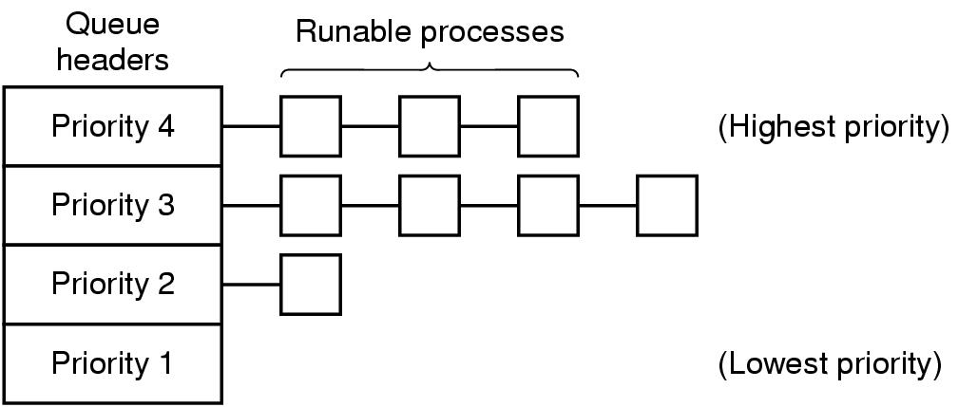
Scheduling in Interactive Systems(cont’d)
Priority Scheduling
  each process is assigned a priority and the runnable process with the highest priority is allowed to run
  priority assigned dynamically or statically
  UNIX command “nice” allows the user to run a process at a lowered priority
  group processes into priority class and use priority scheduling among the classes. Use round-robin within each class

Slide 19
Scheduling in Real-time Systems
Schedule the processes in a way that all deadlines are met
Preemptive priority-based scheduler most used by real-time kernels
Priority
High
TASK 3
Medium
TASK 2
TASK 2
Low
TASK 1
TASK 1
Task 2
preempts
Task 3
preempts
Task 3
completes
Task 2
completes
Task 1
completes
Time

Slide 20
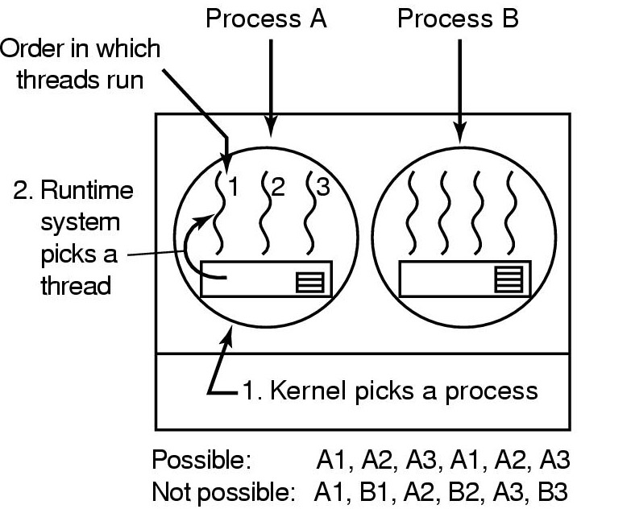
Thread Scheduling-User Level
Possible scheduling of user-level threads
50-msec process quantum
threads run 5 msec/CPU burst

Slide 21
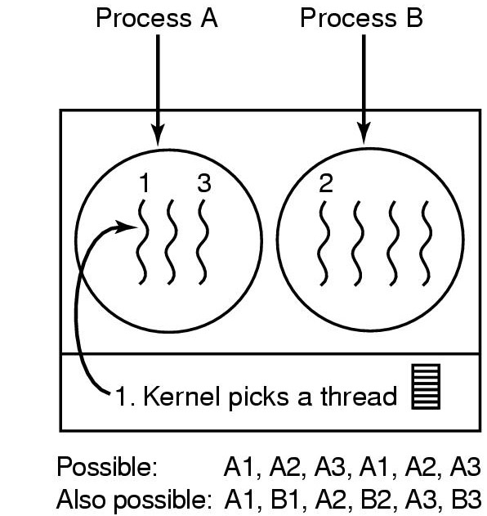
Thread Scheduling-Kernel Level
Possible scheduling of kernel-level threads
50-msec thread quantum

